Slide 1
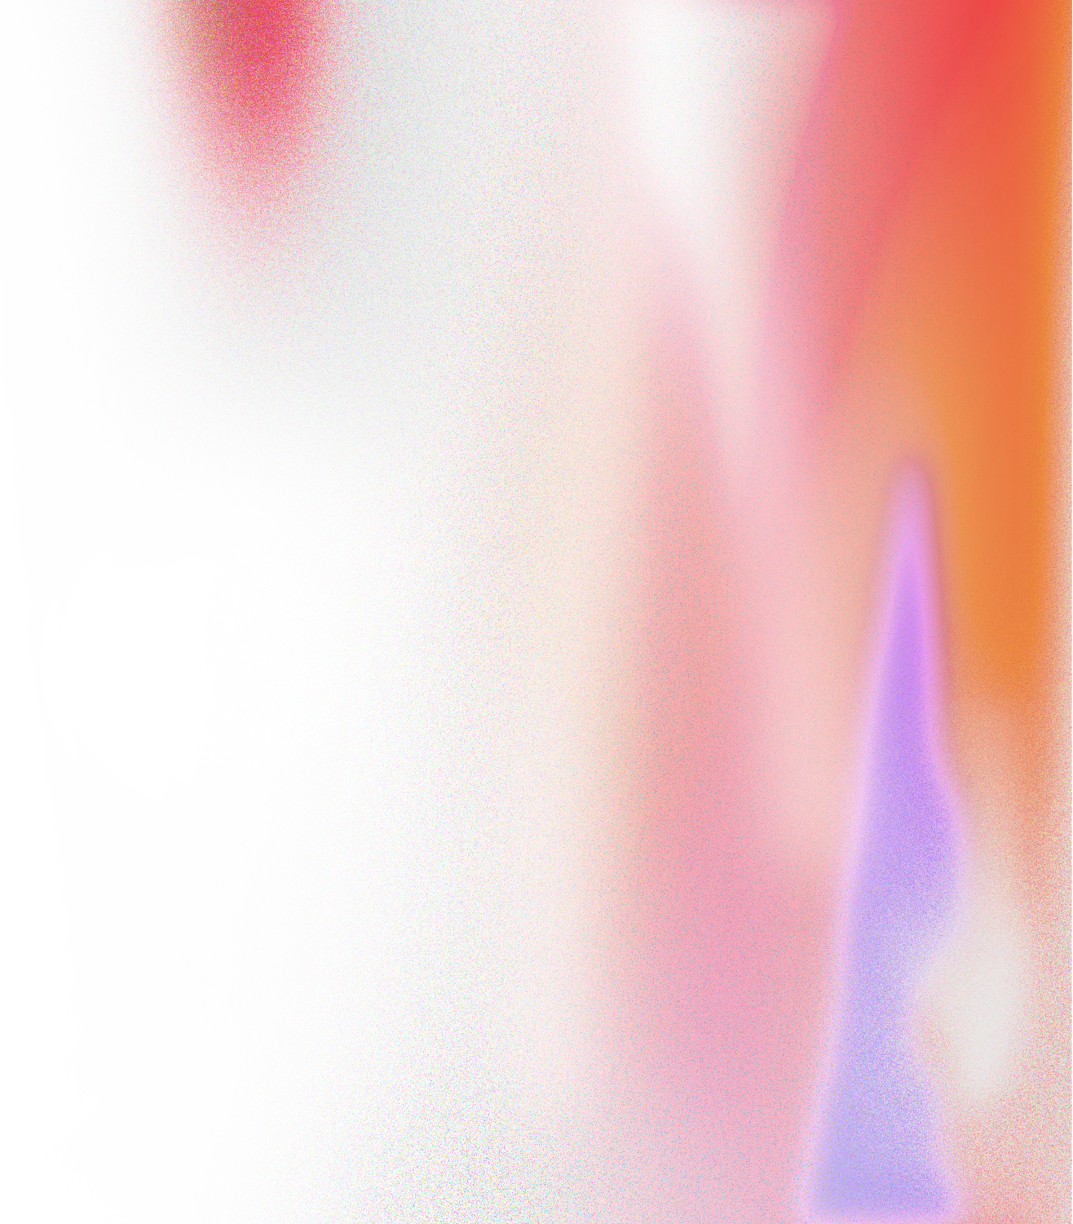


concurrent
project
Filter
Flare
Real-Time Neural Style Transfer on 4K Video
Done by:
Fatima Atwi 6438
Rokaya Alameen 6172
July 2025

Slide 2






concurrent
project
01
Outline
Introduction
Filter Design
Sequential Approach
Parallelization Strategies
Benchmarking
Results

Slide 3

concurrent
project
Why This Project?
Our Motivation :
Demand for real-time high-resolution video effects is increasing.
Style transfer creates artistically transformed content.
4K processing is heavy—needs optimization.
Java concurrency offers underutilized potential in image processing.
02

Slide 4
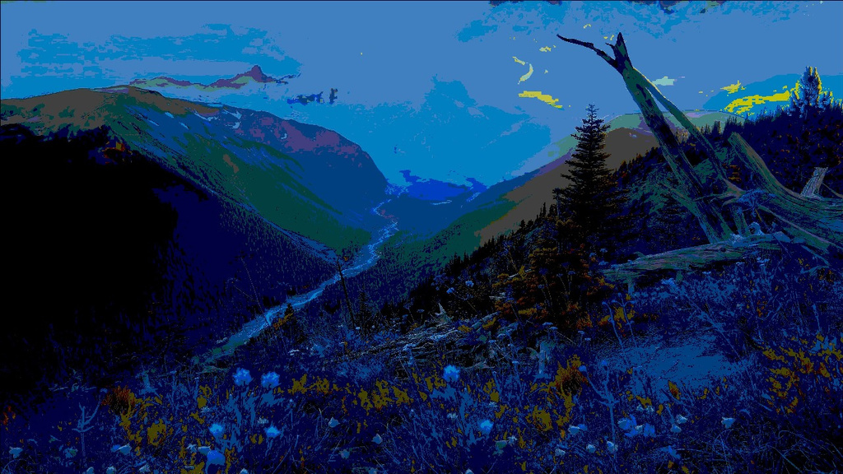
concurrent
project
03
Stylization Pipeline
RGB to HSV Conversion
Hue Remapping
It separates color from brightness and intensity to allow intuitive color manipulation
Forces the color palette toward Van Gogh-style tones by mapping all hues to either deep blue or warm yellow—core colors in his paintings.
Saturation & Brightness Boost
Posterization & Edge Enhancement
Intensifies vibrancy and brightness to mimic the bold, glowing effect of oil paintings
Removes photographic realism for a painterly feel and detects and darkens strong edges to simulate brush strokes

Slide 5
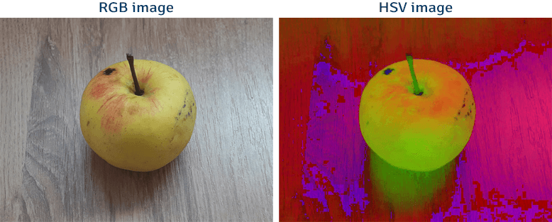
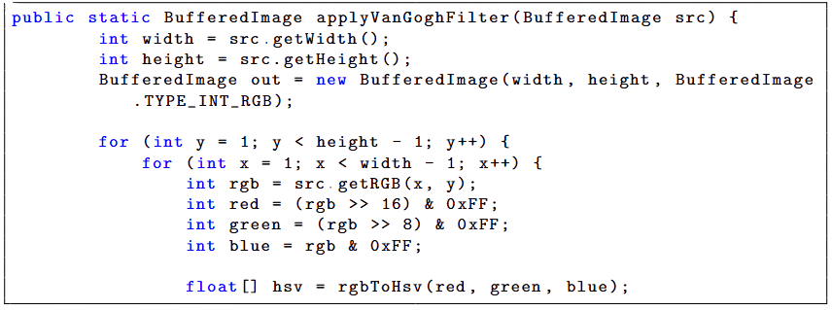

04
concurrent
project
RGB
RGB TO HSV
HSV

Slide 6
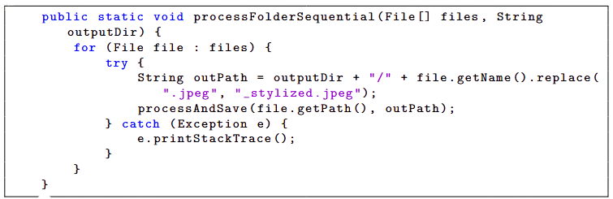
concurrent
project
05
Sequential Approach
process and save method
BufferedImage input = ImageIO.read(new File(inputPath));
BufferedImage output = applyVanGoghFilter(input);
ImageIO.write(output, "jpeg", new File(outputPath));
}

Slide 7
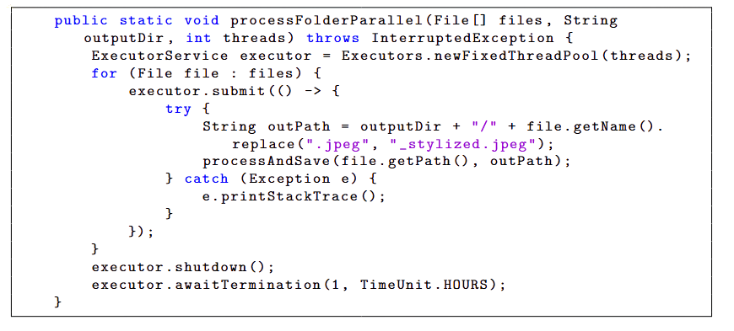
concurrent
project
Parallel Approach: ExecutorService
06

Slide 8
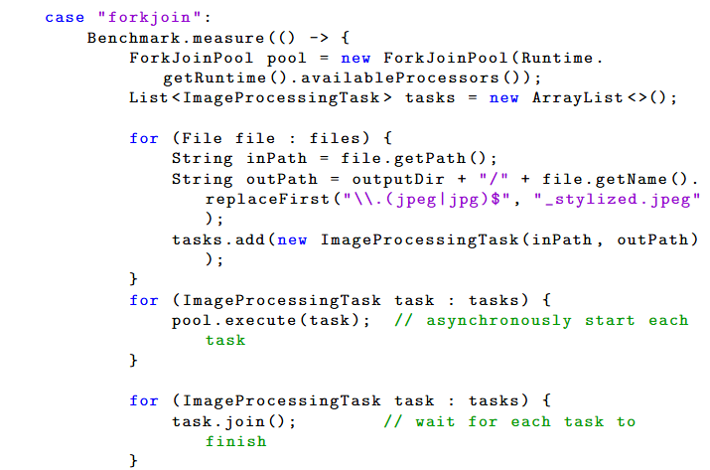
concurrent
project
Parallel Approach: Fork/Join
07

Slide 9
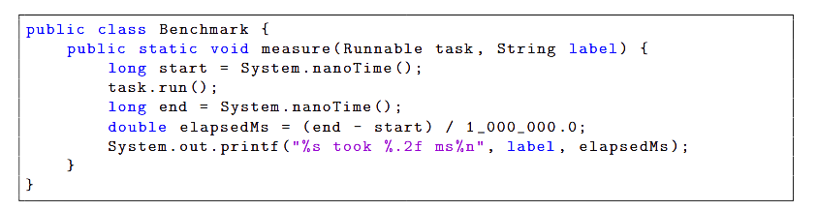
concurrent
project
08
Benchmarking Setup
Sequential took
Parallel took
Fork/Join took
82060.4 MS
13082.5 MS
14198.1 MS

Slide 10
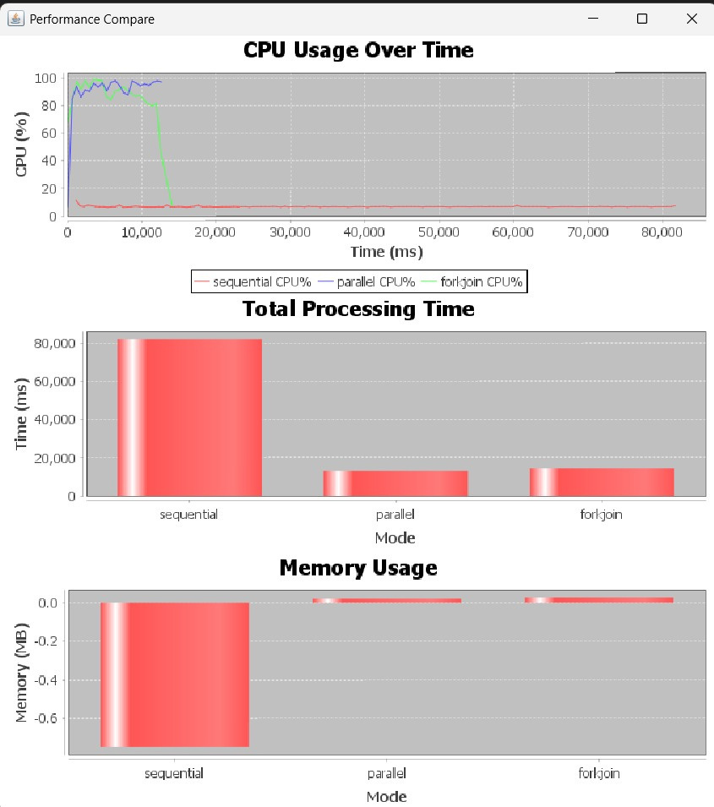
concurrent
project
Results
& Analysis:

Slide 11
concurrent
project
Thank You So much!

